Slide 1
Os tutorials-7 priority scheduling and fifo page replacement algorithm
Team Members:-
Srujan Gowda-4NI19CS107
Vachan C Mendon-4NI19CS117

Slide 2
Non-preemptive priority scheduling algorithm
Priority scheduling is a non-preemptive algorithm and one of the most common scheduling algorithms in batch systems. Each process is assigned first arrival time (less arrival time process first) if two processes have same arrival time, then compare to priorities (highest process first). Also, if two processes have same priority then compare to process number (less process number first). This process is repeated while all process get executed.

Slide 3
implementation
First input the processes with their arrival time, burst time and priority.
First process will schedule, which have the lowest arrival time, if two or more processes will have lowest arrival time, then whoever has higher priority will schedule first.
Now further processes will be schedule according to the arrival time and priority of the process. (Here we are assuming that lower the priority number having higher priority). If two process priority are same then sort according to process number.
Once all the processes have been arrived, we can schedule them based on their priority.

Slide 4
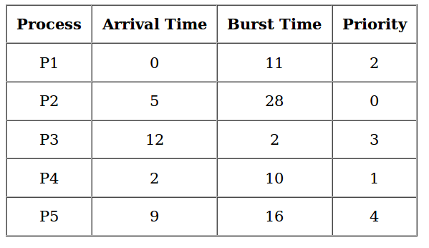
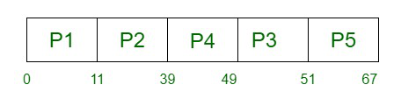
Example :-
Gantt Chart –
Process | Arrival Time(AT) | Burst Time(BT) | Priority | Completion Time(CT) | Turn Around Time(TAT=CT-AT) | Wait Time(WT=TAT-BT)
P1 | 0 | 11 | 2 | 11 | 11 | 0
P2 | 5 | 28 | 0 | 39 | 34 | 6
P3 | 12 | 2 | 3 | 51 | 39 | 37
P4 | 2 | 10 | 1 | 49 | 47 | 37
P5 | 9 | 16 | 4 | 67 | 58 | 42
Response Time(RT)
0
6
37
37
42

Slide 5
Average Wait Time=(0+6+37+37+42)/5
=24.4
Average Turn Around Time=(11+34+39+47+59)/5
=38
Average Response Time=(0+6+37+37+42)/5
=24.4
In a non preemptive scheduling algorithm Wait Time(WT) and Response Time(RT) are always same

Slide 6
Code :-
#include<iostream>
using namespace std;
struct process
{
int id,WT,AT,BT,TAT,PR;
};
struct process a[10];
// function for swapping
void swap(int *b,int *c)
{
int tem;
tem=*c;
*c=*b;
*b=tem;
}

Slide 7
//Driver function
int main()
{
int n,check_ar=0;
int Cmp_time=0;
float Total_WT=0, Total_TAT=0,Avg_WT,Avg_TAT;
cout<<"Enter the number of process \n";
cin>>n;
cout<<"Enter the Arrival time, Burst time and priority of the process\n";
cout<<"AT BT PR\n";
for(int i=0;i<n;i++)
{
cin>>a[i].AT>>a[i].BT>>a[i].PR;
a[i].id=i+1;
// here we are checking that arrival time
// of the process are same or different
if(i==0)
check_ar=a[i].AT;
if(check_ar!=a[i].AT )
check_ar=1;
}

Slide 8
// if process are arrived at the different time
// then sort the process on the basis of AT
if(check_ar!=0)
{
for(int i=0;i<n;i++)
{
for(int j=0;j<n-i-1;j++)
{
if(a[j].AT>a[j+1].AT)
{
swap(&a[j].id,&a[j+1].id);
swap(&a[j].AT,&a[j+1].AT);
swap(&a[j].BT,&a[j+1].BT);
swap(&a[j].PR,&a[j+1].PR);
}
}
}
}

Slide 9
// logic of Priority scheduling (non preemptive) algo
// if all the process are arrived at different time
if(check_ar!=0)
{
a[0].WT=a[0].AT;
a[0].TAT=a[0].BT-a[0].AT;
// cmp_time for completion time
Cmp_time=a[0].TAT;
Total_WT=Total_WT+a[0].WT;
Total_TAT=Total_TAT+a[0].TAT;
for(int i=1;i<n;i++)
{
int min=a[i].PR;
for(int j=i+1;j<n;j++)
{
if(min>a[j].PR && a[j].AT<=Cmp_time)
{
min=a[j].PR;
swap(&a[i].id,&a[j].id);
swap(&a[i].AT,&a[j].AT);
swap(&a[i].BT,&a[j].BT);

Slide 10
swap(&a[i].PR,&a[j].PR);
}
}
a[i].WT=Cmp_time-a[i].AT;
Total_WT=Total_WT+a[i].WT;
// completion time of the process
Cmp_time=Cmp_time+a[i].BT;
// Turn Around Time of the process
// compl-Arival
a[i].TAT=Cmp_time-a[i].AT;
Total_TAT=Total_TAT+a[i].TAT;
}
}
// if all the process are arrived at same time
else
{
for(int i=0;i<n;i++)
{
int min=a[i].PR;

Slide 11
for(int j=i+1;j<n;j++)
{
if(min>a[j].PR && a[j].AT<=Cmp_time)
{
min=a[j].PR;
swap(&a[i].id,&a[j].id);
swap(&a[i].AT,&a[j].AT);
swap(&a[i].BT,&a[j].BT);
swap(&a[i].PR,&a[j].PR);
}
}
a[i].WT=Cmp_time-a[i].AT;
// completion time of the process
Cmp_time=Cmp_time+a[i].BT;
// Turn Around Time of the process
// compl-Arrival
a[i].TAT=Cmp_time-a[i].AT;
Total_WT=Total_WT+a[i].WT;
Total_TAT=Total_TAT+a[i].TAT;
}

Slide 12
}
Avg_WT=Total_WT/n;
Avg_TAT=Total_TAT/n;
// Printing of the results
cout<<"The process are\n";
cout<<"ID WT TAT\n";
for(int i=0;i<n;i++)
{
cout<<a[i].id<<" "<<a[i].WT<<" "<<a[i].TAT<<endl;
}
cout<<"Avg waiting time is: "<<Avg_WT<<"ms"<<endl;
cout<<"Avg turn around time is: "<<Avg_TAT<<"ms";
return 0;
}

Slide 13
Advantages :-
This provides a good mechanism where the relative importance of each process maybe precisely defined.
Priority is considered. Critical processes can get even better response time.

Slide 14
Disadvantages:-
If high priority processes use up a lot of CPU time, lower priority processes may starve and be postponed indefinitely.The situation where a process never gets scheduled to run is called starvation.
Another problem is deciding which process gets which priority level assigned to it.

Slide 15
First-in first-out( fifo) algorithm :-
This is the simplest page replacement algorithm. In this algorithm, the operating system keeps track of all pages in the memory in a queue, the oldest page is in the front of the queue. When a page needs to be replaced page in the front of the queue is selected for removal.

Slide 16
Implementation :-
1- Start traversing the pages.
i) If set holds less pages than capacity.
a) Insert page into the set one by one until
the size of set reaches capacity or all
page requests are processed.
b) Simultaneously maintain the pages in the
queue to perform FIFO.
c) Increment page fault
ii) Else
If current page is present in set, do nothing.
Else
a) Remove the first page from the queue
as it was the first to be entered in
the memory
b) Replace the first page in the queue with
the current page in the string.
c) Store current page in the queue.
d) Increment page faults.
2. Return page faults.

Slide 17
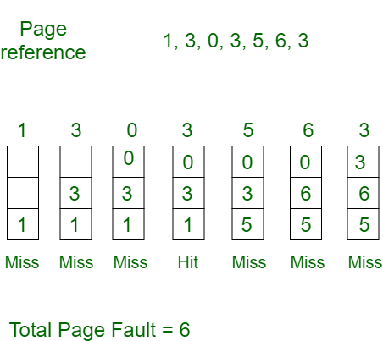
Example :-
Consider page reference string 1, 3, 0, 3, 5, 6,3 with 3 page frames . Find number of page faults.
Initially all slots are empty, so when 1, 3, 0 came they are allocated to the empty slots —> 3 Page Faults. when 3 comes, it is already in memory so —> 0 Page Faults. Then 5 comes, it is not available in memory so it replaces the oldest page slot i.e 1. —>1 Page Fault. 6 comes, it is also not available in memory so it replaces the oldest page slot i.e 3 —>1 Page Fault. Finally when 3 come it is not available so it replaces 0 1 page fault

Slide 18
Code :-
#include<iostream >
#include<vector>
#include<unordered_set>
#include<queue>
using namespace std;
// Function to find page faults using FIFO
int pageFaults(vector<int> pages, int n, int capacity)
{
// To represent set of current pages. We use an unordered_set so that we quickly check if a page is present in set or not
unordered_set<int> s;
// To store the pages in FIFO manner
queue<int> indexes;
// Start from initial page
int page_faults = 0;
for (int i=0; i<n; i++)
{

Slide 19
// Check if the set can hold more pages
if (s.size() < capacity)
{
// Insert it into set if not present already which represents page fault
if (s.find(pages[i])==s.end())
{
// Insert the current page into the set
s.insert(pages[i]);
// increment page fault
page_faults++;
// Push the current page into the queue
indexes.push(pages[i]);
}
}
// If the set is full then need to perform FIFO i.e. remove the first page of the queue from set and queue both andl insert the current page
ese
{
// Check if current page is not already present in the set
if (s.find(pages[i]) == s.end())
{

Slide 20
// Store the first page in the queue to be used to find and erase the page from the set
int val = indexes.front();
// Pop the first page from the queue
indexes.pop();
// Remove the indexes page from the set
s.erase(val);
// insert the current page in the set
s.insert(pages[i]);
// push the current page into the queue
indexes.push(pages[i]);
// Increment page faults
page_faults++;
}
}
}
return page_faults;
}

Slide 21
// Driver code
int main()
{
vector<int> pages(100);
cout<<"Enter the number of pages"<<endl;
int n;
cout<<"Enter the pages"<<endl;
for(int i=0;i<n;i++){
cin>>pages[i];
}
int capacity = 4;
cout <<"Number of page faults = "<< pageFaults(pages, n, capacity)<<endl;
cout<<"Number of hits = "<<n-pageFaults(pages,n,capacity)<<endl;
cout<<"Hit ratio = "<<(n-pageFaults(pages,n,capacity))/(float)n;
cout<<"Miss ratio = "<<pageFaults(pages,n,capacity)/(float)n;
return 0;
}

Slide 22
Advantages :-
It is simple and easy to understand & implement.

Slide 23
Disadvantages :-
The process effectiveness is low.
When we increase the number of frames while using FIFO, we are giving more memory to processes. So, page fault should decrease, but here the page faults are increasing. This problem is called as Belady’s Anomaly.
Every frame needs to be taken account off.

